Slide 1


Naan Mudhalvan
Salesforce Developer
PROJECT TITLE: Property Management Application Using Salesforce
TEAM MEMBER
COURSE INSTRUCTOR
Mr.R.AYYAPPAN
COLLEGE SPOC
Mr.T.KARTHIKEYAN
DEEPIKA S V(611220205002)
RAMYA SRI R(611220205027)(TEAM LEAD)
SHRI SHALINI M (611220205033)
TEAJASHREE R (611220205042)

Slide 2
PROJECT GOAL:
Developing a Property Management Application Using Salesforce represents a significant opportunity to modernize and streamline the property management industry. This project's overarching goal is to enhance the efficiency and effectiveness of property management processes.
PROJECT DESCRIPTION:
Develop an App for the Property Management where Buyer can order his Requirements and get the Appropriate Details of the Property. According to his interest just provide him with some discounts up to what extent he can get the discount. Also Track Whether he is Interested in taking the loan available for so just calculate how much loan Amount user can get it. Provide the Security for two different profiles like for marketing and sales team.

Slide 3
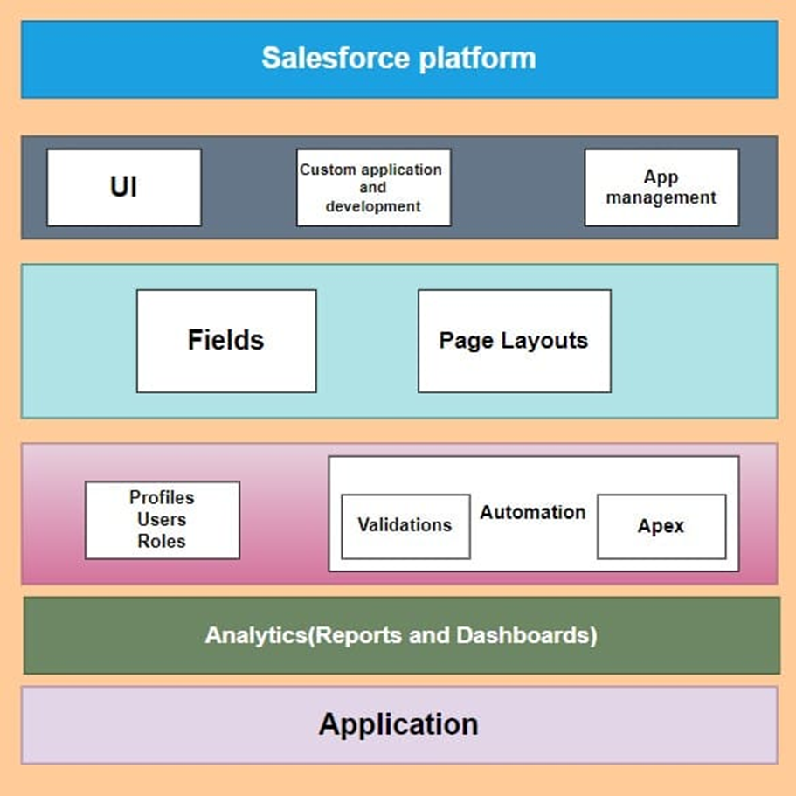
TECHNICAL ARCHITECTURE

Slide 4

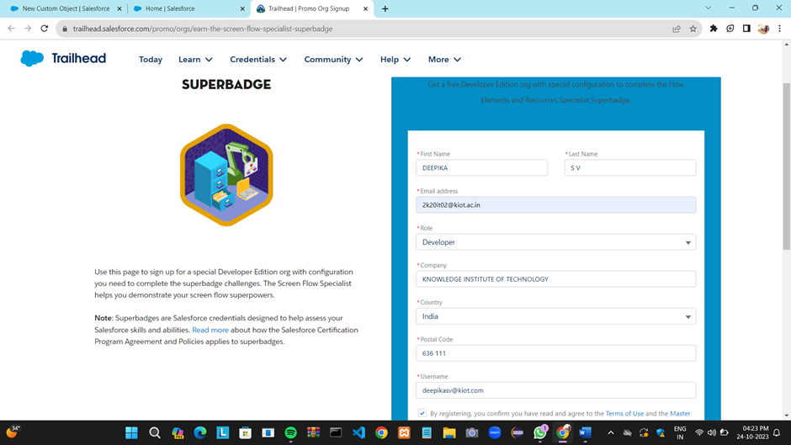
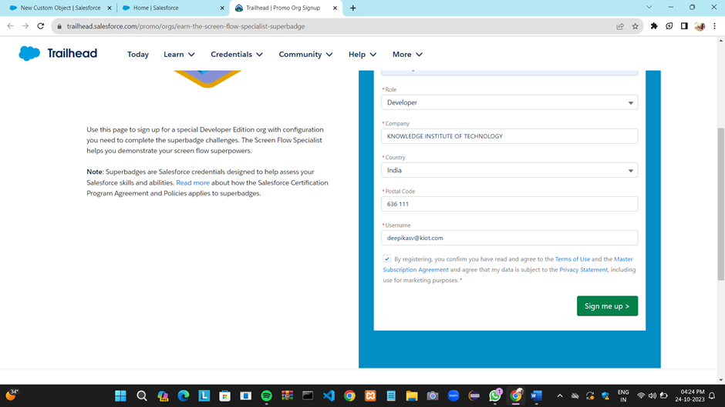
SALESFORCE DEVELOPER ORG

Slide 5
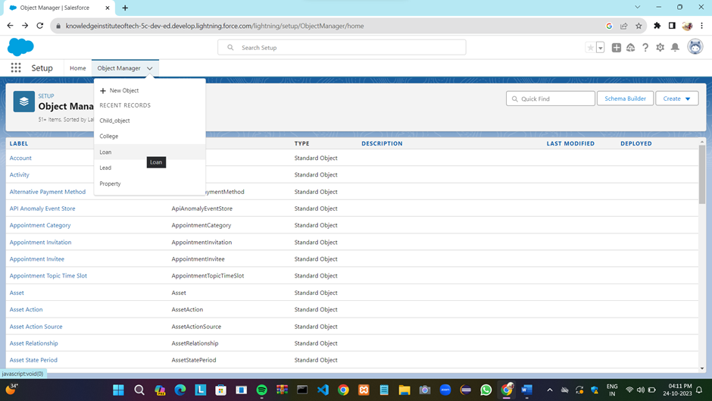
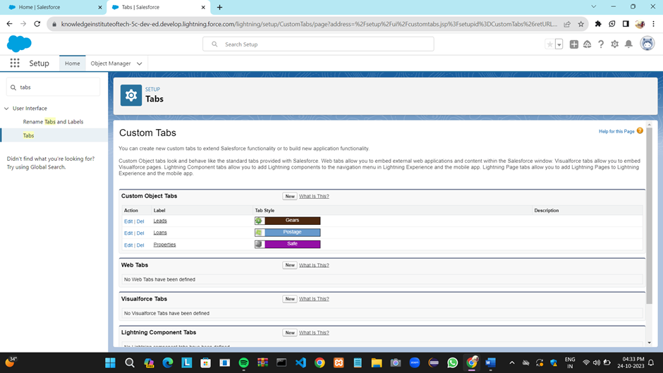
CUSTOM OBJECT CREATION & TABS

Slide 6
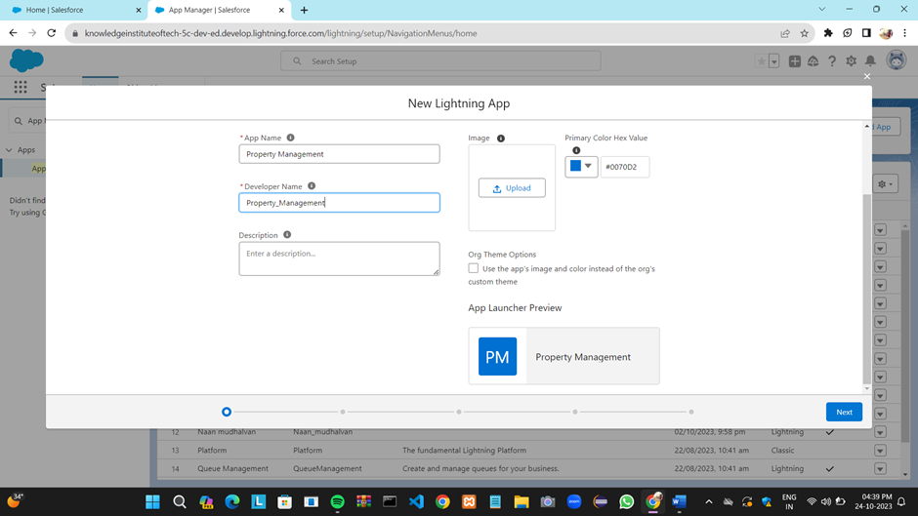
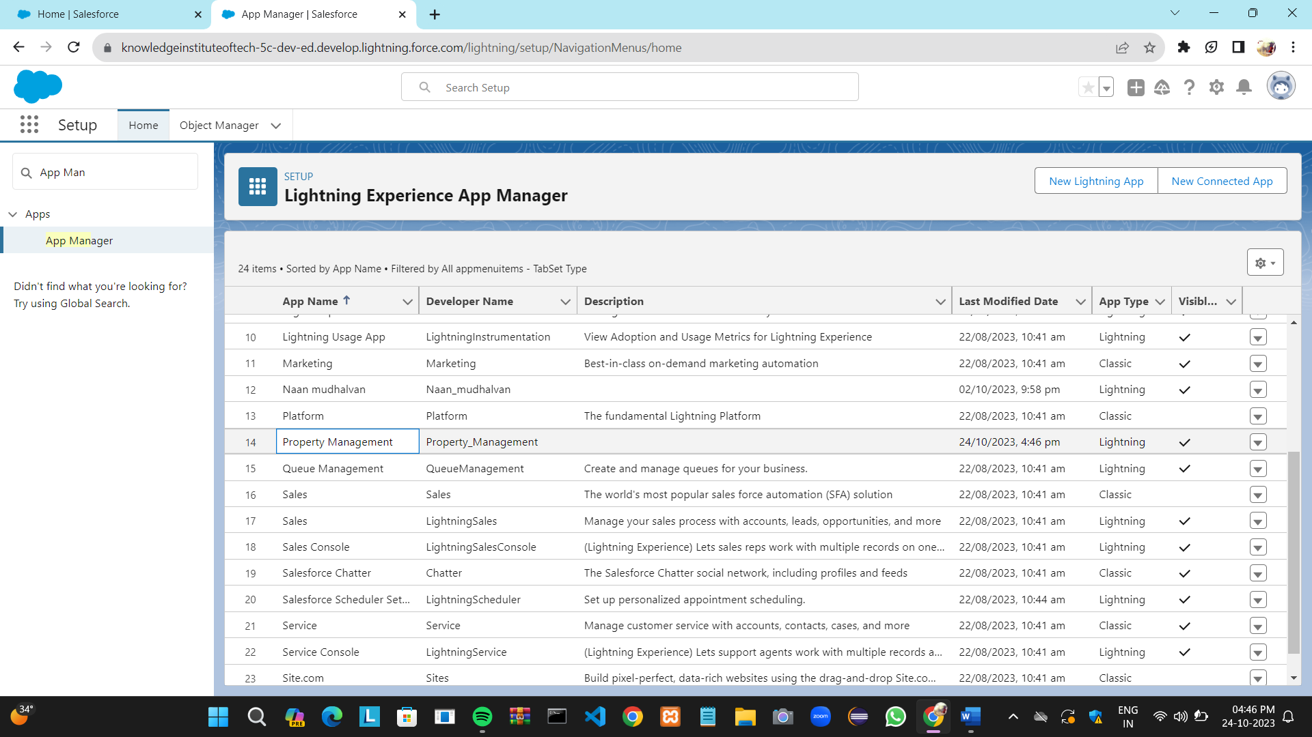
LIGHTNING APP

Slide 7
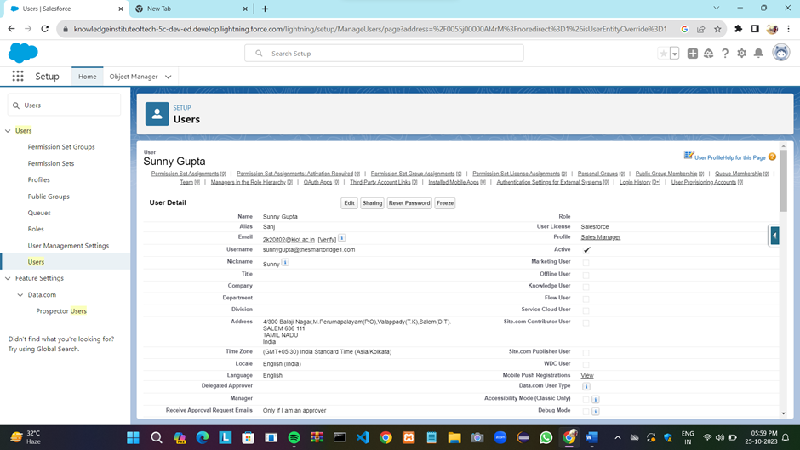
USER CREATION

Slide 8
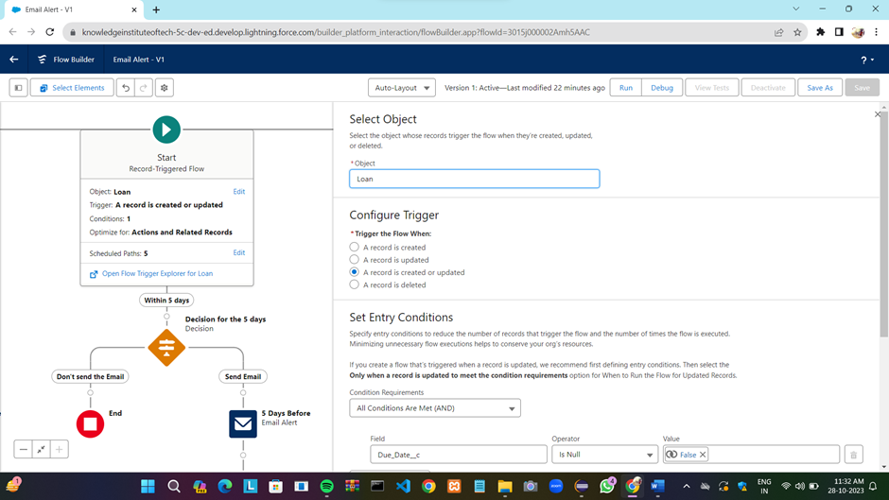
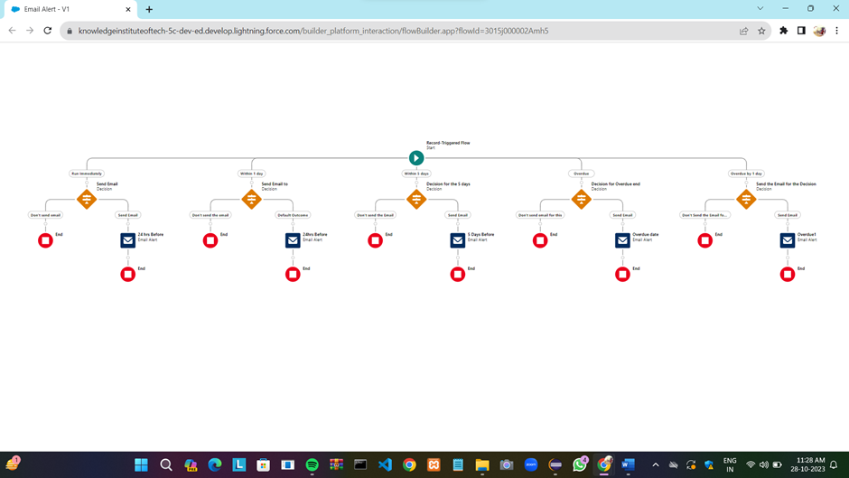
FLOWS

Slide 9
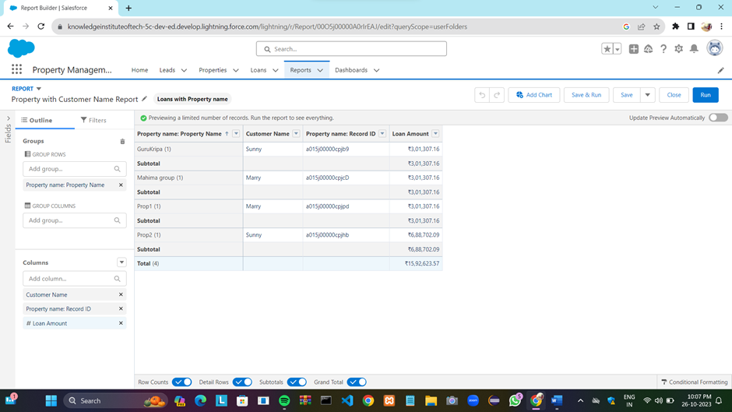
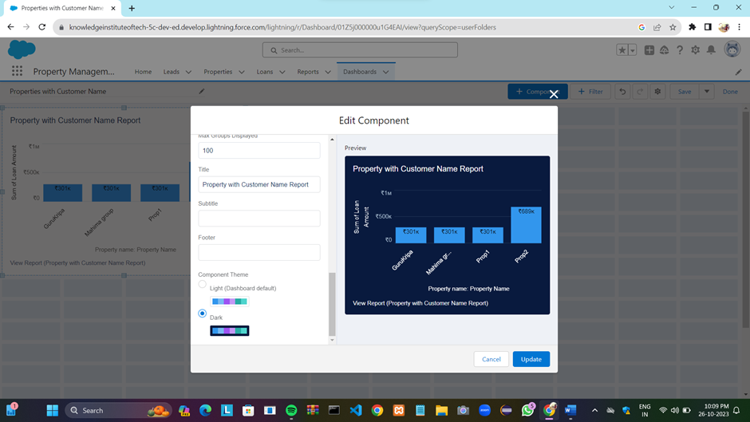
REPORTS AND DASHBOARD

Slide 10

Thank You

